Slide 1
Proof of Concept
Project Scope

Slide 2
Project Priorities
Cheap
Fast production (2 weeks, ideal, 4 max)
Basic functionality (can ask questions, gets answer from bank account info)
If possible at all, connect to artificial intelligence platform to show AI functionality (natural language processing)

Slide 3
Ideal Project Objectives
Konviv will have a functioning, well designed, and elegant MVP to demo to banks, possible investors, mentors, and other partners asap.
MVP will be able to support the following on an iOS application (see Appendix B):
Intuitive and accessible onboarding process
Have a functioning chatbot that allows users to ask questions about their multiple banking accounts
Chatbot feels conversational, personable, is intuitive and easy to use
Able to answer questions in English and Spanish
Show user banking account information by connecting Konviv platform to (multiple) bank APIs
Dashboard that shows aggregate financial account information for multiple banks in one place (organized by banking institution). Dashboard will show:
Checking, savings accounts, and credit card balances for all bank accounts user has
Tools section (shows user’s credit score - hard coded if we can’t pull their actual credit score)
User profile information
**Artificial Intelligence: ideally, we would love to show some minimal AI functionality. This could be as simple as connecting to an off-the-shelf solution that already exists, such as IBM Watson or API.ai to make the conversation seem more natural and personable. This is NOT a must have, but an ideal.

Slide 4
Project Work-Product
Necessary
- Chatbot feature that user can ask questions of and get answers from real bank data (10-15 basic questions- see slide 5))
- Yodlee, Plaid, or Dwolla API to extract financial info to answer question posed by user
- Dashboard with the following screens: Dashboard (for Account Info), Tools and "Chat" buttons
Ideal functionality
- Working iOS Mobile Application that can be downloaded on a user's phone
- Icon on iOS Desktop
- Login / register screen
- Facebook login capabilities
- Dashboard landing page will have summary of multiple accounts (Slide 9,WF4)
- Accounts should connect to user's actual bank accounts using API
- Tools section will be a landing page that links to pretend credit score / financial data. Content will be static (static content pending) (Slide 11, WF6)
- UI + Designs will be submitted by Konviv team
-Connects to AI solution to make conversation more natural (via NLP)

Slide 5
Chatbot Questions List
These are our best examples, but we may change this list before building out the full question list
Question
Mappings
Sample Answers List
How much do I have in my checking account
Can you give me a full summary of my accounts?
How much did I spend on coffee this month?
Can I get a total of all accounts?
Which account did I last pay on?
What was my most expensive bill?
How much do I have in my savings account?
What is my average spending amount?
What were my last 5 transactions?
How much did I spend today?
You have $3,593.92 in your checking account.
Your checking account has $3,593.92 in it, your savings account has $2,200 in it, and your credit card has $345/$500 left on it.
This month, you have spent $14.54 on coffee.
The total you have in all of your accounts is: $5,793.92
Your last payment was $32.99 from your checking account for EARPHONES – BestBuy
Your most expensive bill this month was $193.00 on T-MOBILE
You have $2,200 in your savings account.
Your daily average for spending is $74.59
Your last 5 transactions are $2.59 on Peet’s Coffee, $10.49 at Target, $22.39 on Chevron, $9.89 at Campus Store, $13.36 on AC Transit Card
Today, you have spent $45.36.

Slide 6
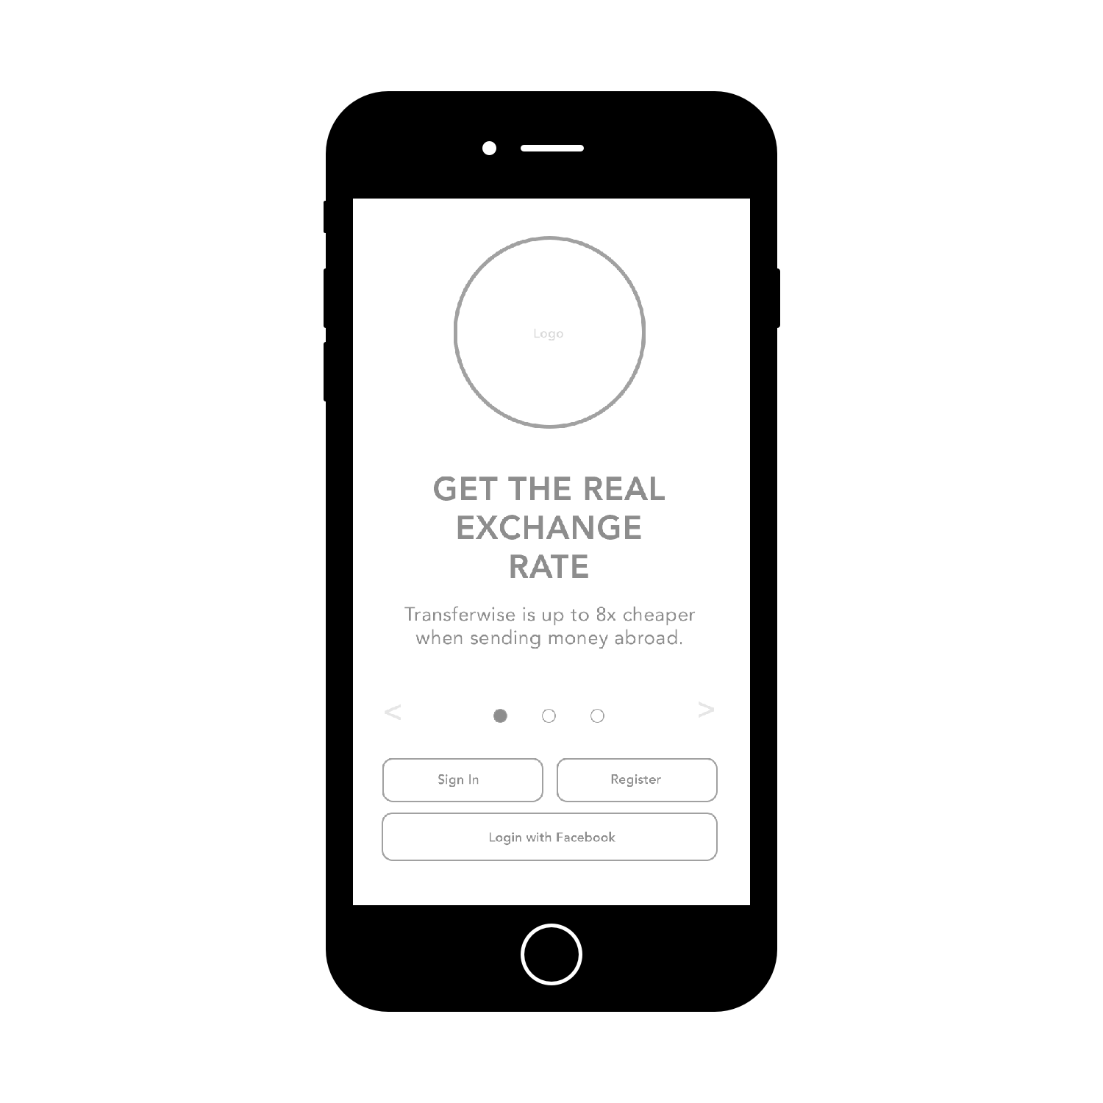

WF 1
Landing Screen
This is the 1 screen we still need to design for you - but this will show you the basics of what we are thinking about for the landing screen, which is a way for users to (1) Register (2) Login or (3)Sign in with Facebook.
The landing screen will have the Konviv logo and probably a title text area and a smaller text area

Slide 7
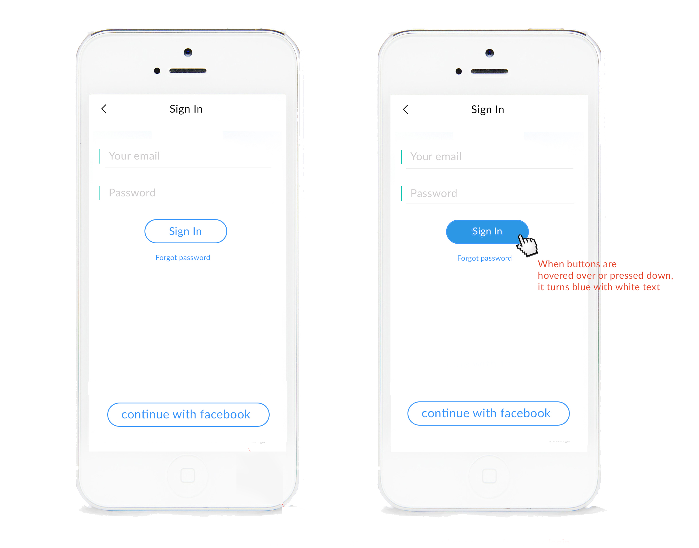
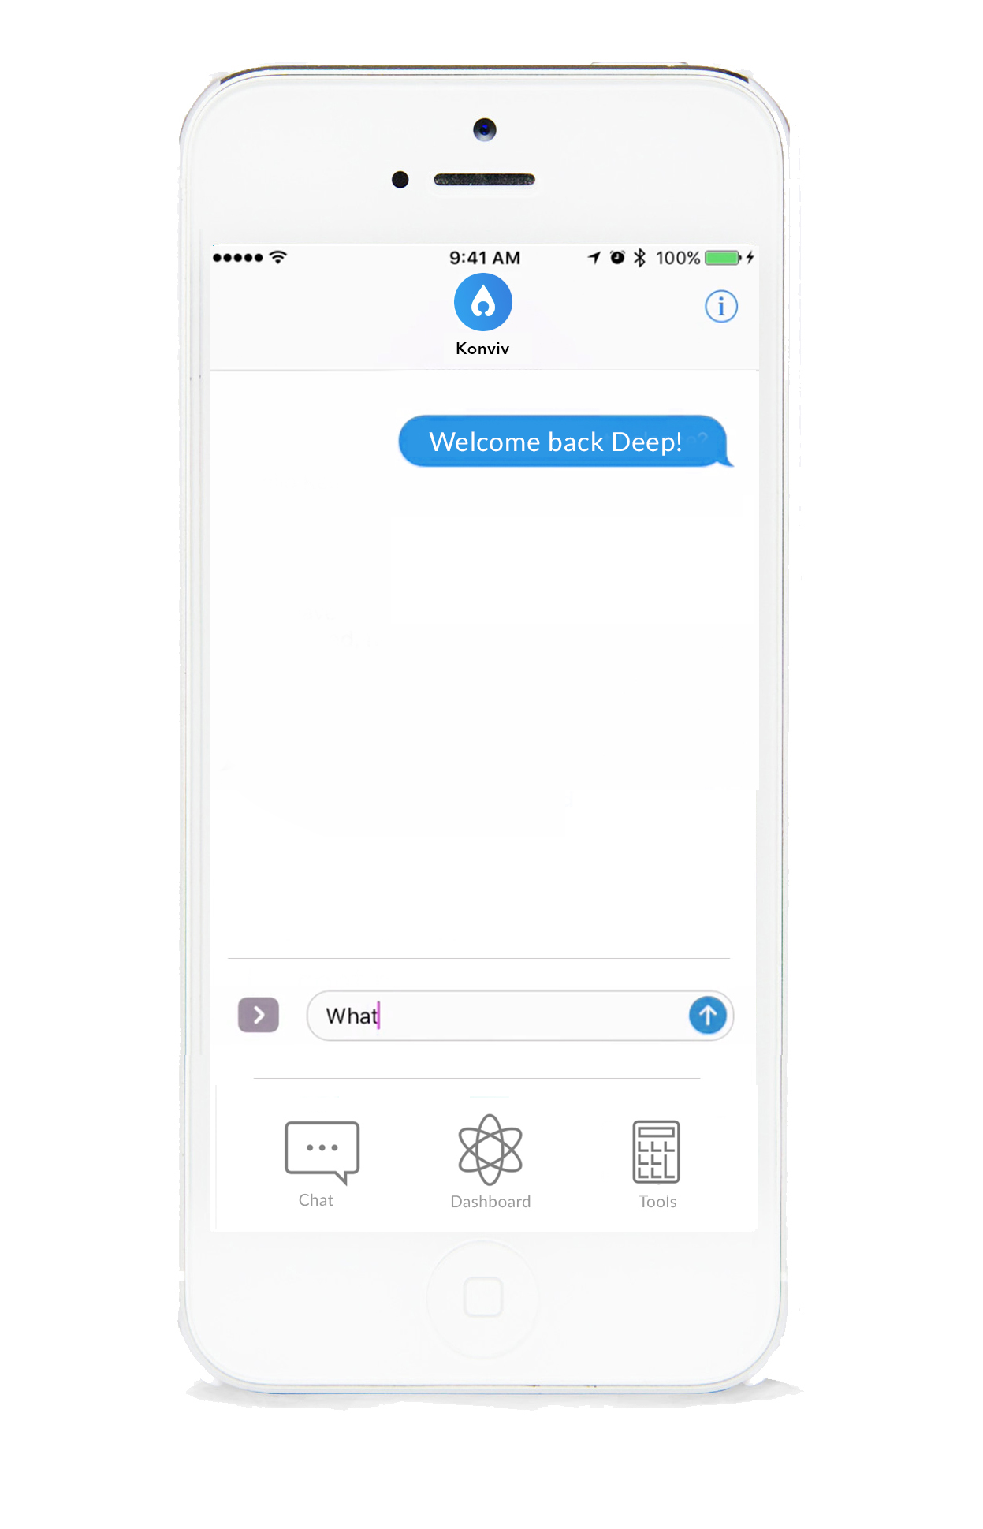
WF 2
Sign In

Slide 8
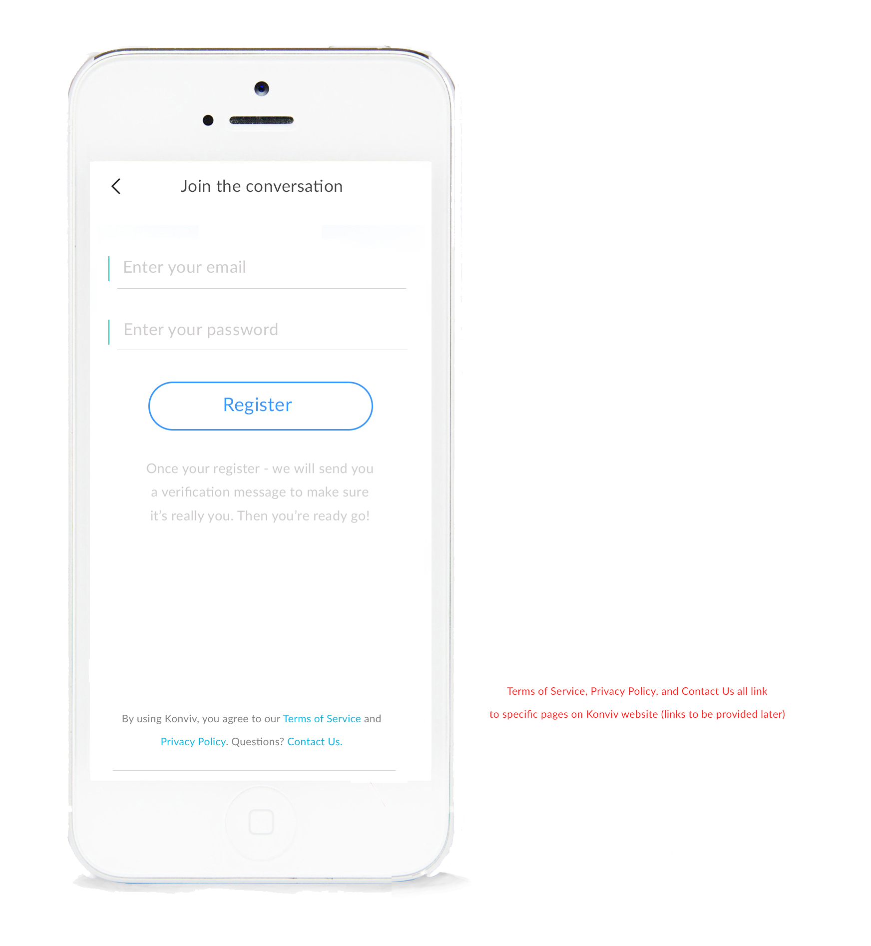
WF 3
Register

Slide 9
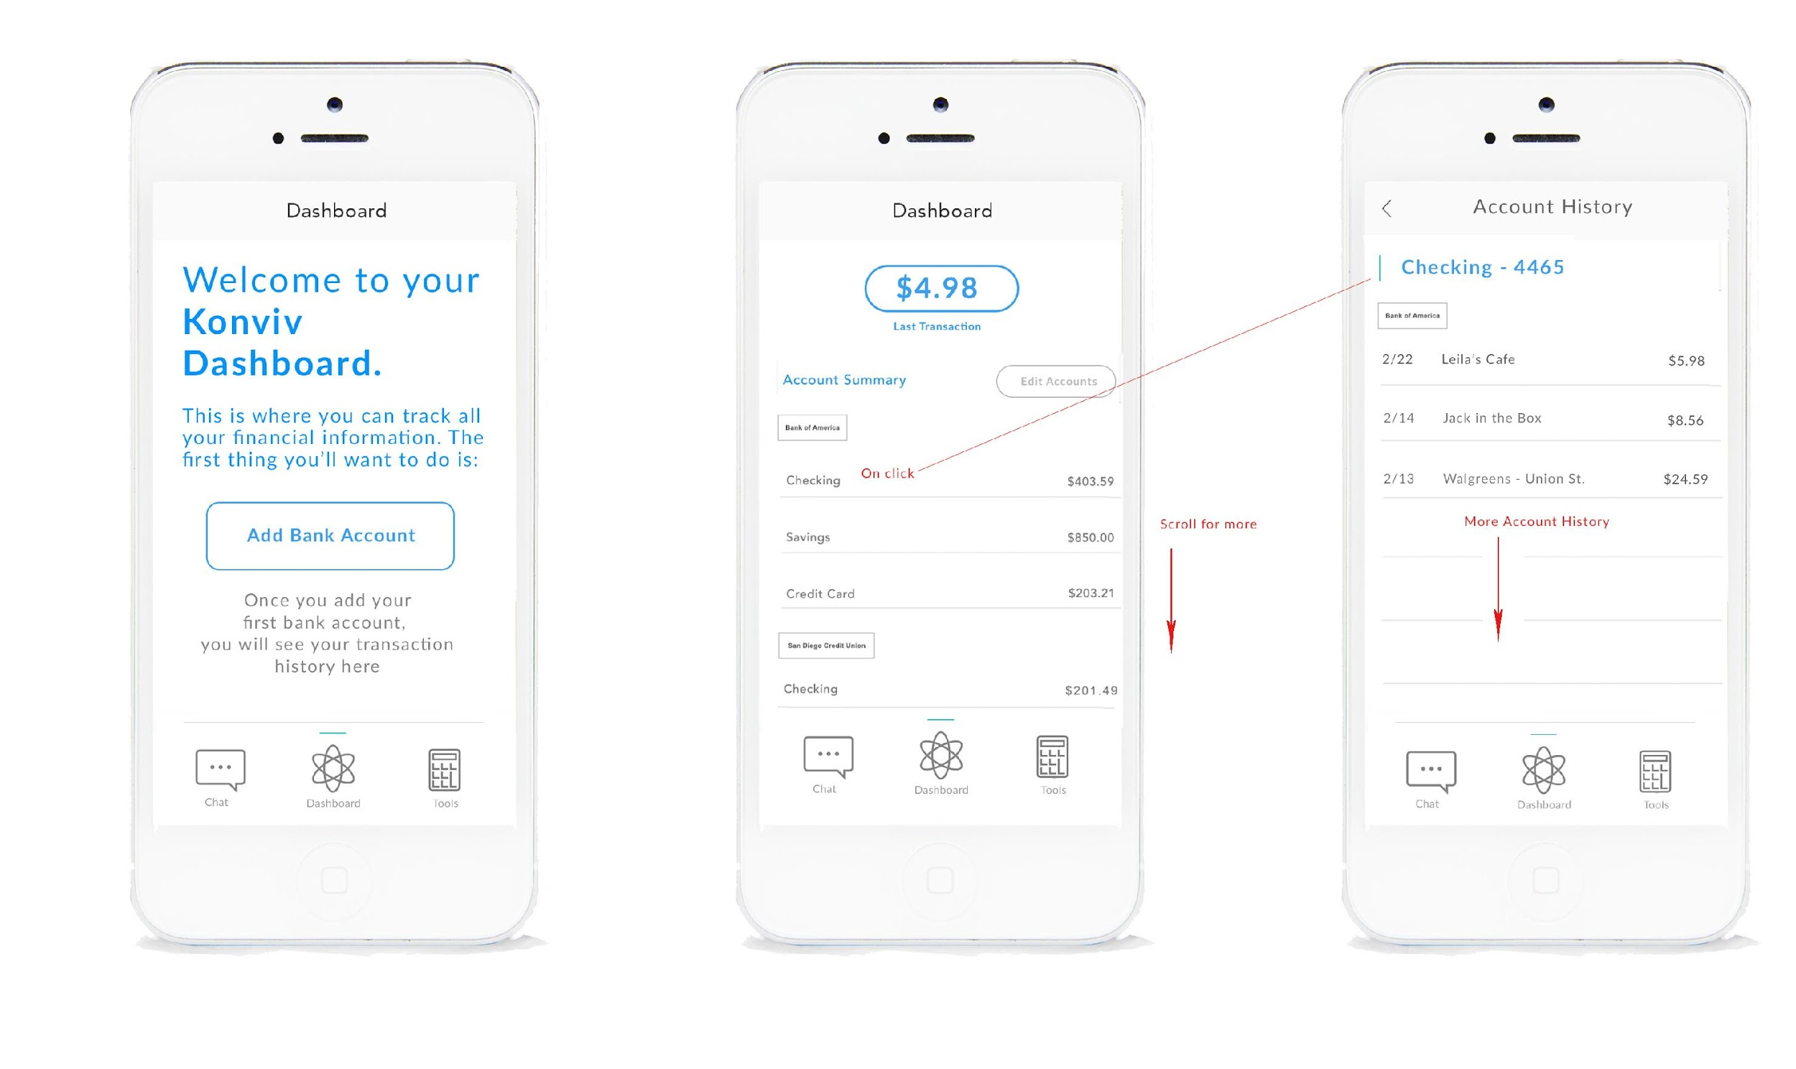
WF 4
Dashboard New User
Dashboard Regular (once user has added their bank)

Slide 10
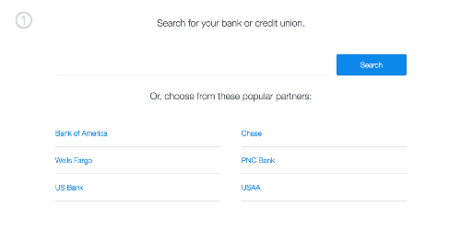
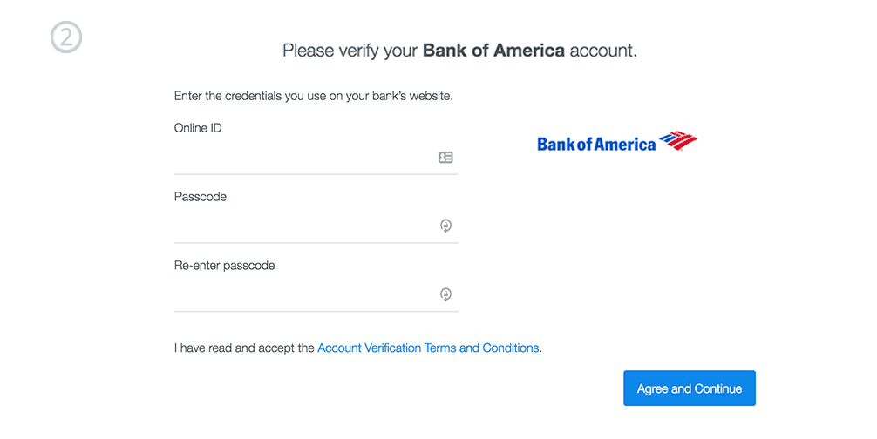
WF 5
Adding A Bank Account
API example

Slide 11
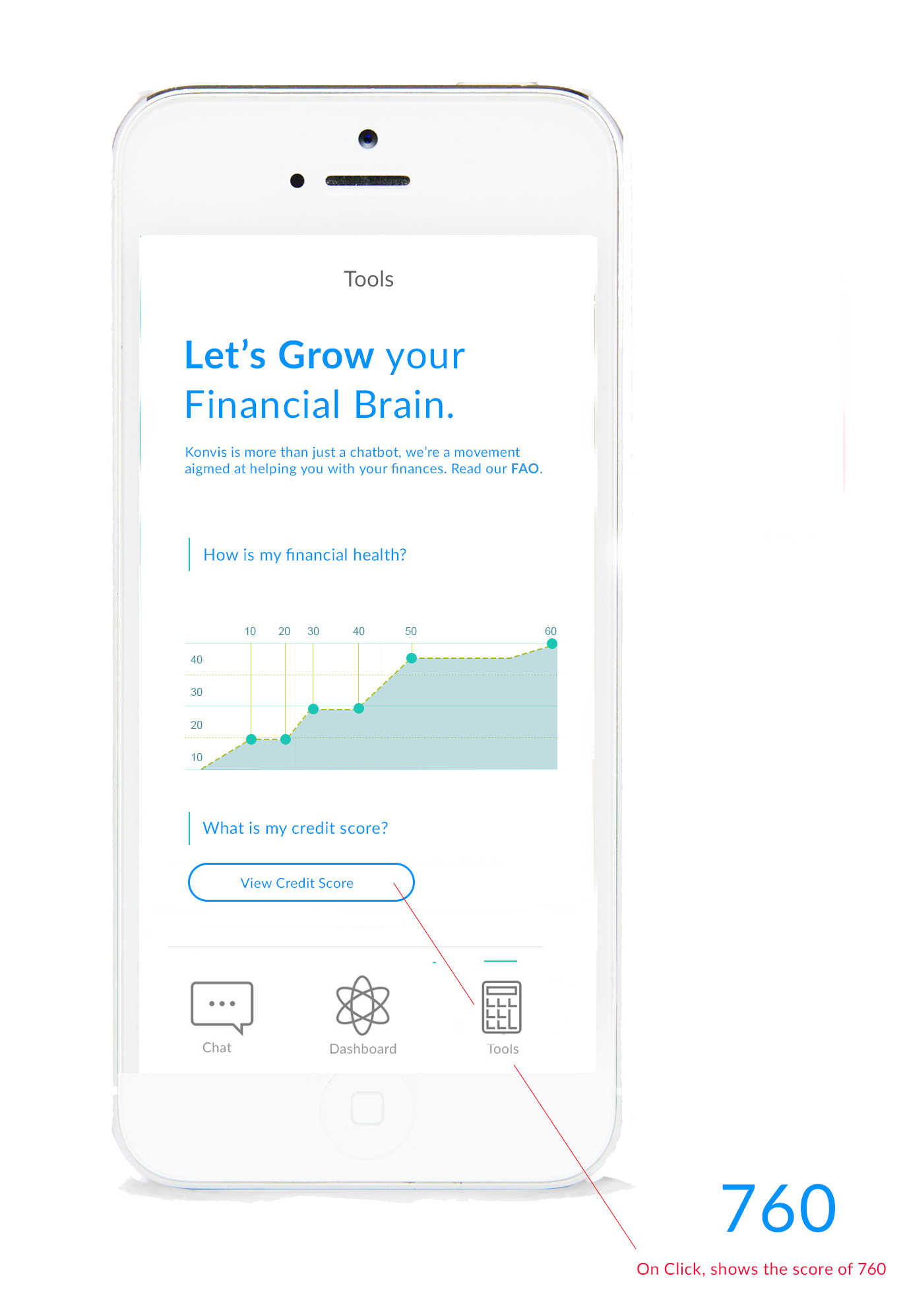
WF 6
Tools

Slide 12
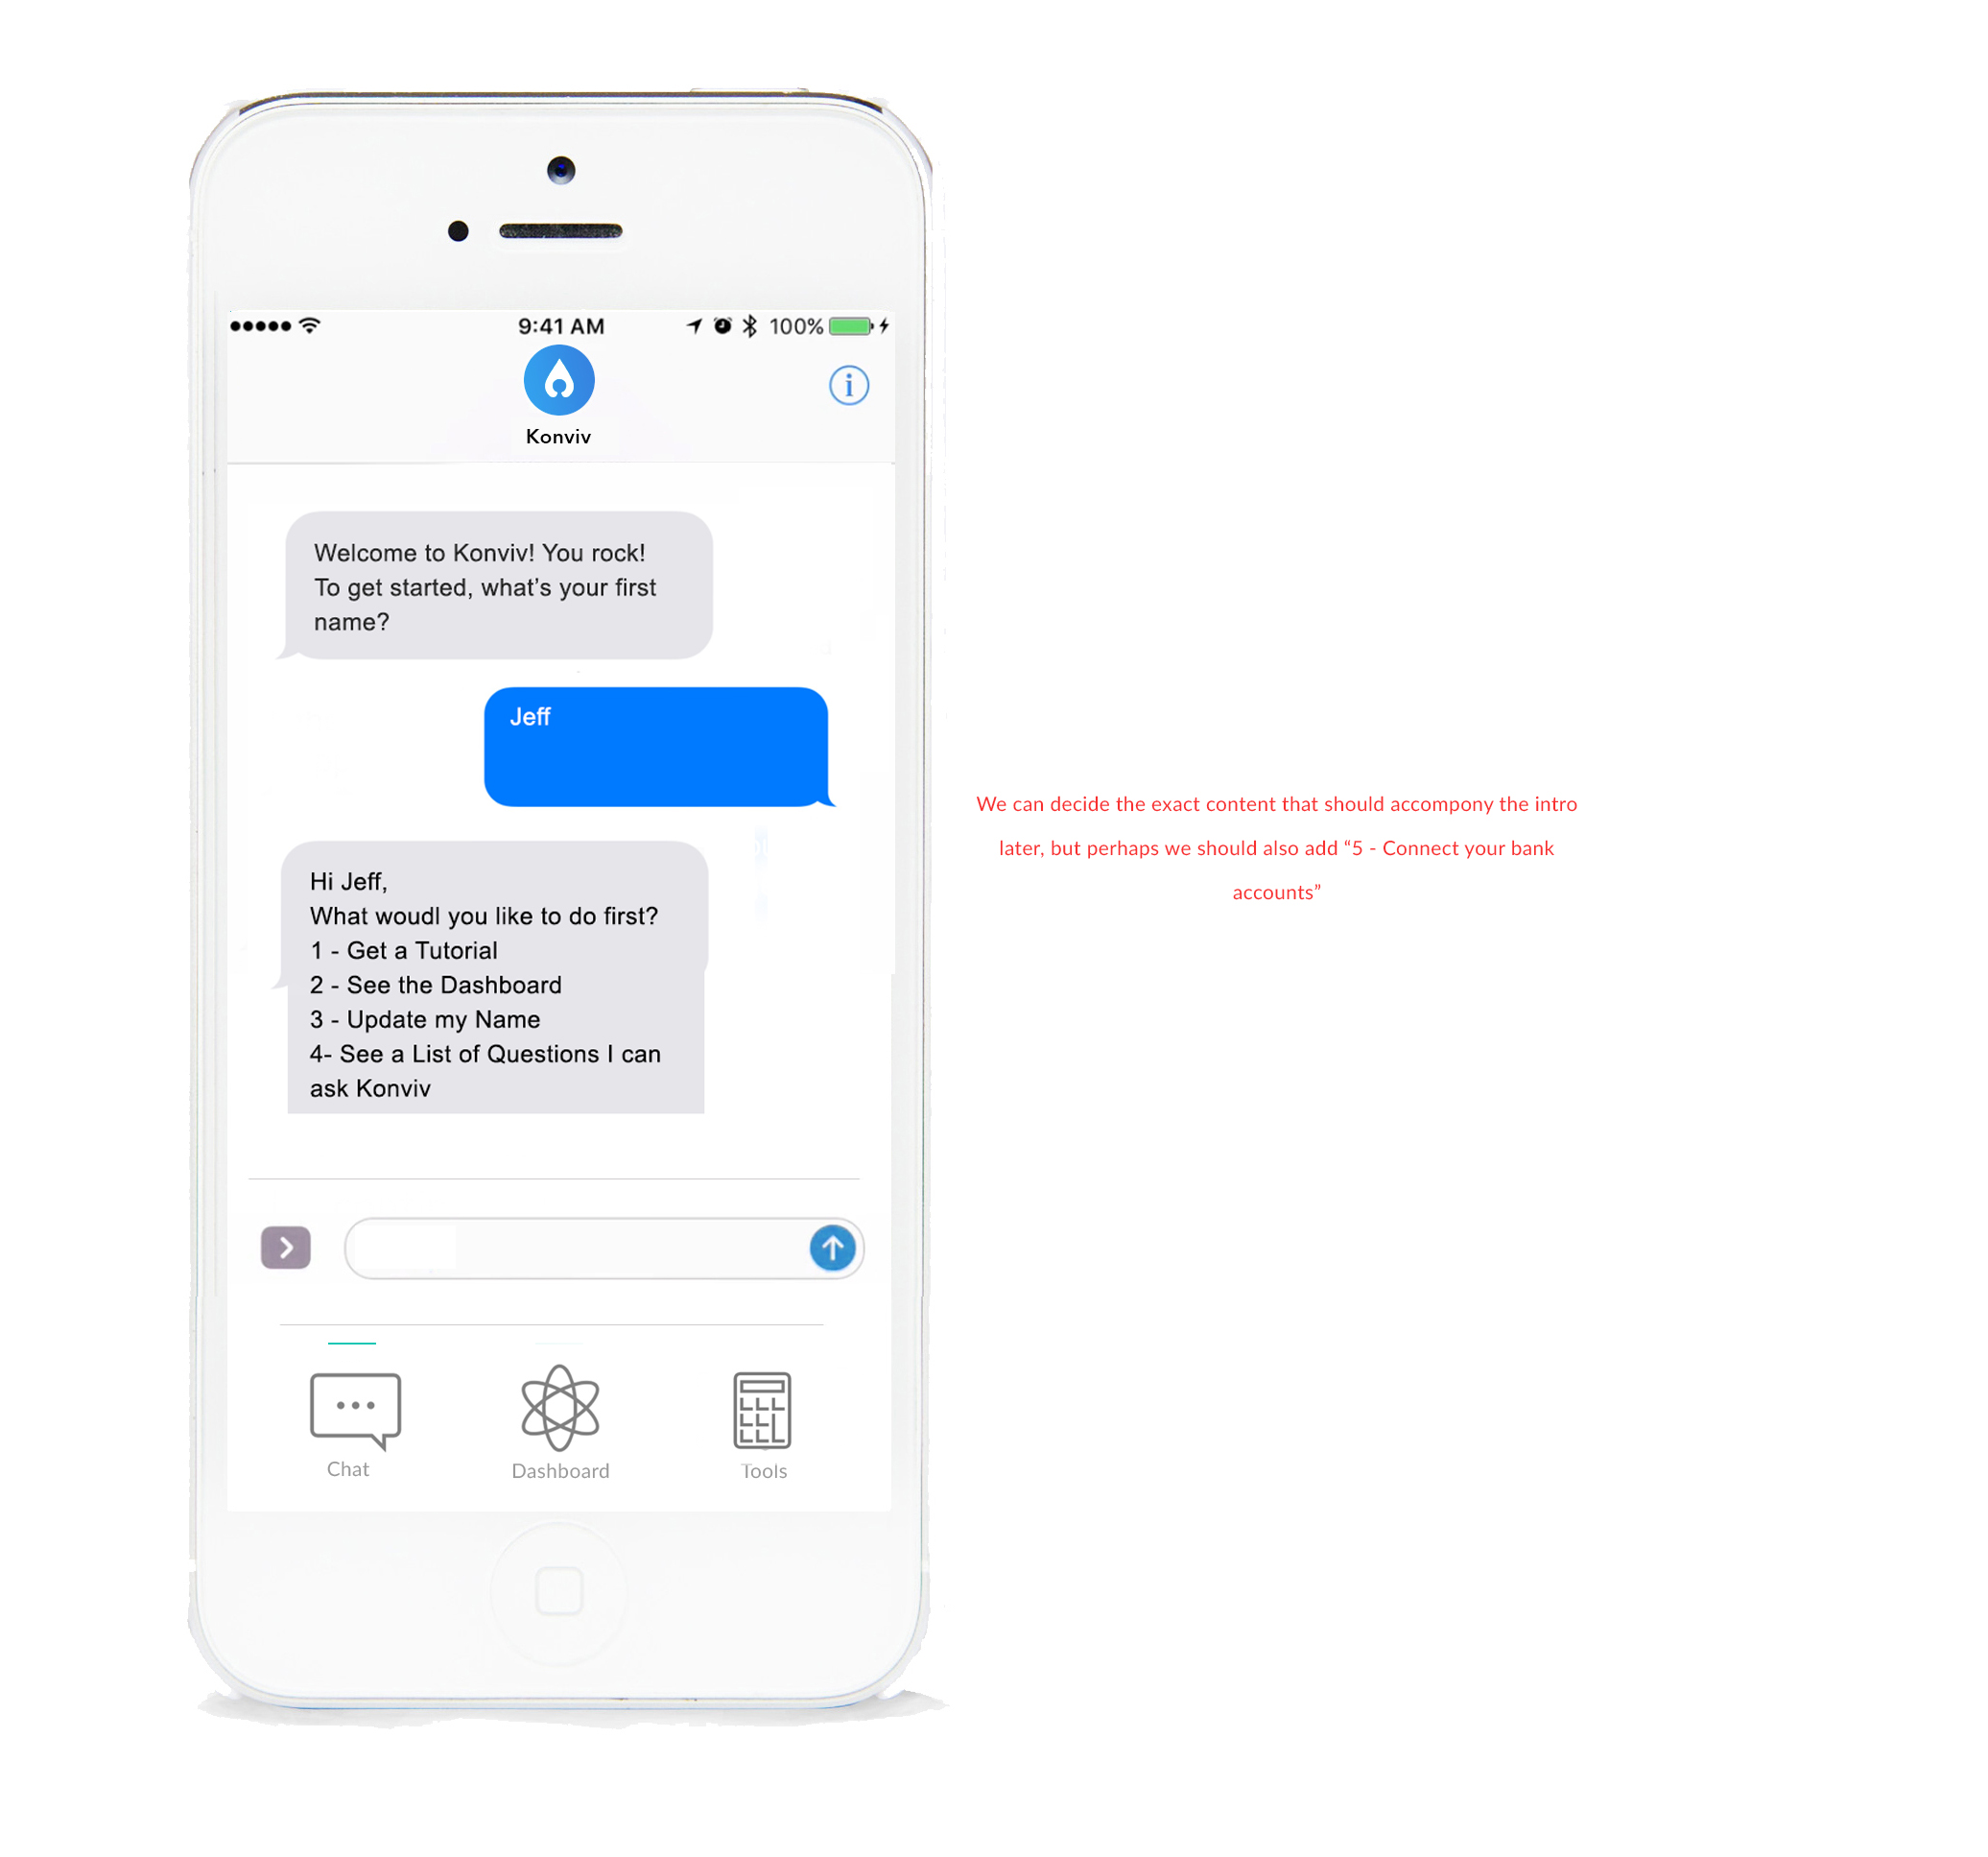
WF 7
Chat Feature
We are hoping that questions can be initiated by keywords that will retrieve the correct banking information.
For example, when a user types “checking” or “how much money do I have in my checking account?” - the app will recognize the keyword and return something like:
“You have $459.49 in your checking account.”

Slide 13
Similar products
Abe: https://www.abe.ai/
Penny: https://www.pennyapp.io/
Calisto: http://kasisto.com/
Olivia: https://www.olivia.ai/

Slide 14
Developer Work-Product
Please provide us a proposal outlining:
Cost of various options of development (basic, ideal, others?)
Timeline
Questions you have for us (or concerns as to what might be hard to implement)
Materials or information you need us to share with you
Anything else you’d like to share with us, recommendations, anything you might need from us, etc.

Slide 15
Questions we have for you
If any of the chat questions require responses that have to do math, is that possible? (For example: What is my average daily spending?)
Do you have any experience working with AI solutions (IBM Watson) in the past?

